Slide 1
ACS6300 Robotics Project and Dissertation Topic:- MR Fluid Based Haptic Feedback System by, Samanta Suprio Sujoy Project Code and Title: SD1, Medical Robotics- VR/AR for telerobotics
Supervisor :- Professor Sanja Dogramadzi
Second Reader :- Professor Michael Balikhin

Slide 2
Outline
Aims and Objectives
Background
Typical Behaviour of MR Fluids
Haptic Feedback System
Methodology
The Silicone Haptic Device
Results from Early Prototypes
Overall System
Results
Conclusion and Future Work

Slide 3
Aims and Objectives
Aim:- To design, manufacture, and assess a tactile feedback system that utilizes magnetorheological fluid to generate lateral and normal forces.
Objectives
To use the Hagen-Poiseuille law and the Herschel-Bulkley model to explain the fluid behavior.
To engineer a silicon rubber haptic device with intricate internal veins and strategically placed input/output ports to enable precise fluid flow control for a single finger.
To develop a system to control and drive the MR fluid using electromagnets, a peristaltic pump, and an Arduino microcontroller board.
To assess the forces generated by the haptic device using a 6-axis load cell sensor.

Slide 4
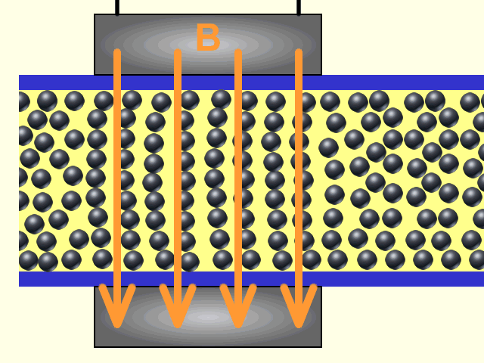
Background
What are Magnetorheological Fluids?
Image produced from [1]
Ferromagnetic particles
Carrier Fluid
Respond to magnetic Field
Chain Formation of particles
[1]Wikipedia Contributors, “Magnetorheological fluid,” Wikipedia, Aug. 13, 2018. https://en.wikipedia.org/wiki/Magnetorheological_fluid

Slide 5
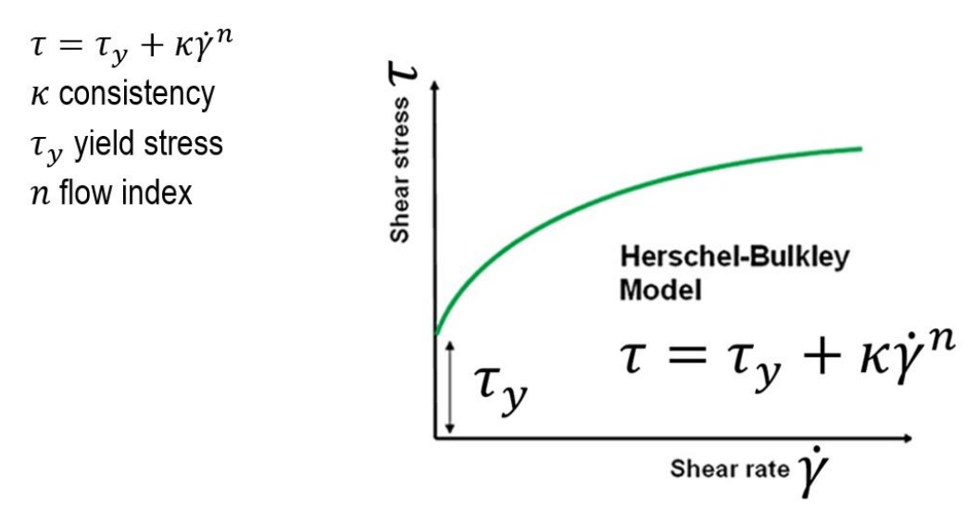
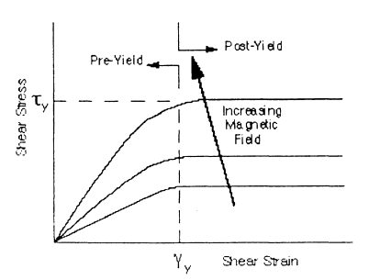
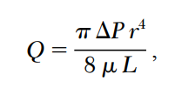
Typical Behaviour of an MR Fluid
Image Produced from [1]
Image produced from [2]
Pre Yielding behaves as Newtonian Fluid.
Hagen-Poiseuille law
Post Yielding behaves as Non-Newtonian Fluid.
Herschel-Bulkley Model
n = 1 corresponds to Newtonian behavior
n < 1 indicates shear-thinning behavior
n > 1 indicates shear-thickening behavior
[1] O. Ashour, C. A. Rogers, and W. Kordonsky, “Magnetorheological Fluids: Materials, Characterization, and Devices,” Journal of intelligent material systems and structures, vol. 7, no. 2, pp. 123–130, 1996, doi: 10.1177/1045389X9600700201.
[2] A. Perry, “Explicit Pressure Drop Equations for Herschel-Bulkley Fluid Flow in Pipes,” Center for Model-Based Cyber-Physical Product Development, vol. 20, no. 12, pp. 15–15, Feb. 2018, Accessed: Aug. 31, 2023. [Online]. Available: https://wcc.ep.liu.se/index.php/MODPROD/article/view/634/551

Slide 6
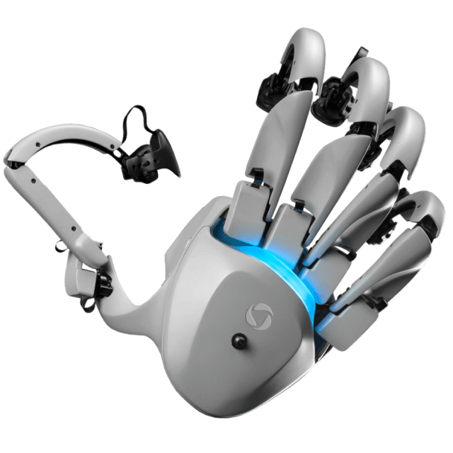
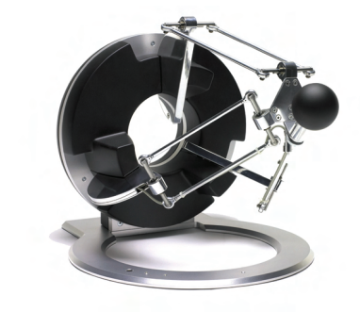
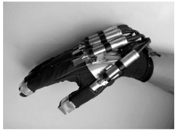
Haptic Feedback Systems
Image produced from [1]
Tesla Glove
Tactile information through force, vibration or touch.
Sensation of touch, pressure, temperature and texture through tactile receptors.
Two main haptic technology:
kinesthetic feedback
Force Feedback on ligaments and muscles
Move with humans and effect large areas of the body
Active and Resistive device
TeslaGlove and Omega3
MR Fluid based smart glove by Nam et.al
Image produced from [2]
Image produced from [3]
Omega 3
MR Fluid actuator
[3]Yoon Kwon Nam, M. K. Park, and R. Yamane, “Smart glove: hand master using magnetorheological fluid actuators,” Proceedings of SPIE, Dec. 2007, doi: https://doi.org/10.1117/12.783776.
[1]“Haptic Glove for Virtual Reality with Force Feedback | TESLAGLOVE,” Teslasuit. https://teslasuit.io/products/teslaglove/
‌
[2]“omega.x,” Force Dimension. https://www.forcedimension.com/products/omega (accessed Aug. 31, 2023).

Slide 7
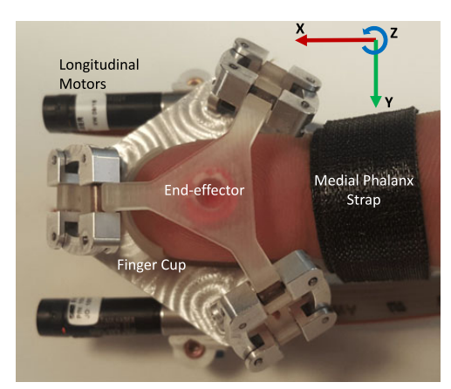
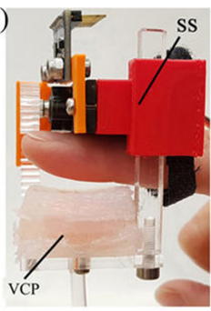
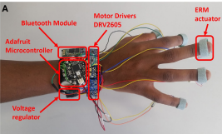
Image produced from [1]
3-DOF delta mechanism
Cutaneous feedback
Provide normal or lateral forces through Vibration, Pressure Electrotactile, Ultrasonic, Thermal
Samuel et.al [1] developed a 3DOF skin deformation device, which uses a delta mechanism to generate lateral forces.
Antonia et. al [2] designed a wearable fingertip haptic device that provide cutaneous feedback through inflation and control of a membrane.
Andualem et.al [3] used the DRV2605 haptic motor drivers to develop vibrotactile cutaneous feedback for a virtual environment.
Image produced from [2]
Image produced from [3]
[1]S. B. Schorr and A. M. Okamura, “Three-Dimensional Skin Deformation as Force Substitution: Wearable Device Design and Performance During Haptic Exploration of Virtual Environments,” IEEE Transactions on Haptics, vol. 10, no. 3, pp. 418–430, Jul. 2017, doi: https://doi.org/10.1109/toh.2017.2672969.
[2]A. Tzemanaki, G. A. Al, C. Melhuish, and S. Dogramadzi, “Design of a Wearable Fingertip Haptic Device for Remote Palpation: Characterisation and Interface with a Virtual Environment,” Frontiers in Robotics and AI, vol. 5, Jun. 2018, doi: https://doi.org/10.3389/frobt.2018.00062.
[3]A. T. Maereg, A. Nagar, D. Reid, and E. L. Secco, “Wearable Vibrotactile Haptic Device for Stiffness Discrimination during Virtual Interactions,” Frontiers in Robotics and AI, vol. 4, Sep. 2017, doi: https://doi.org/10.3389/frobt.2017.00042.
Pressure based haptic device
Vibration based haptic device

Slide 8
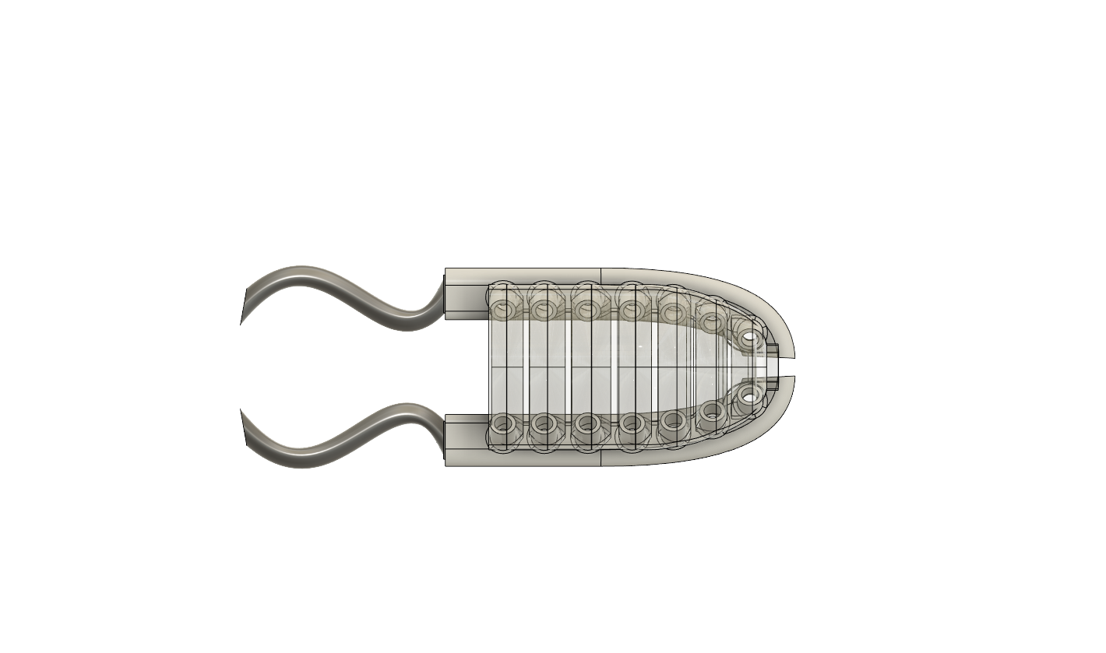
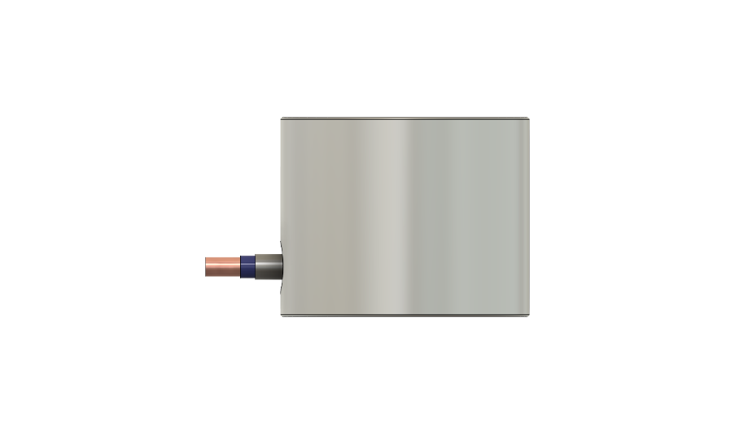
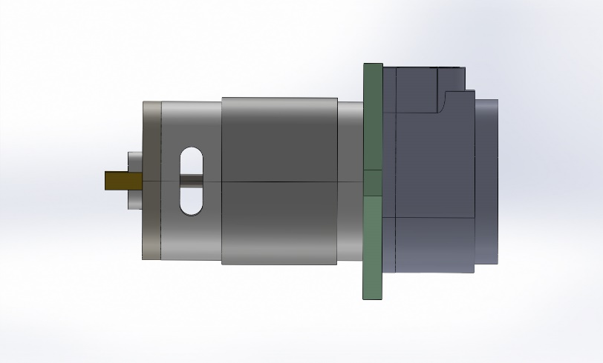
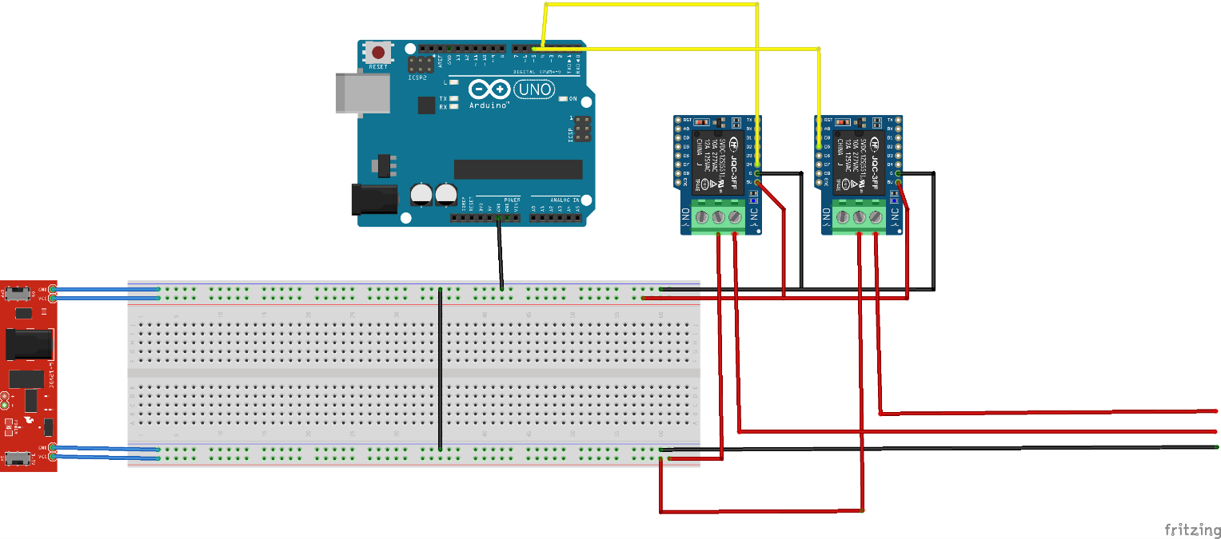
Methodology
Inlet Pipe
Silicone haptic device
Arduino signals the relay, turning them ON or OFF.
Based on the Arduino's signal, the relay closes the circuit supplying power to the peristaltic pump and the electromagnet.
The pump, in the ON state, circulates the fluid around the patch
The electromagnet, turns the fluid into semi-soild, when magnetized.
Outlet
Reservoir
Electromagnet
Arduino Uno
Peristaltic Pump
Source: author
Relays
Power Supply

Slide 9
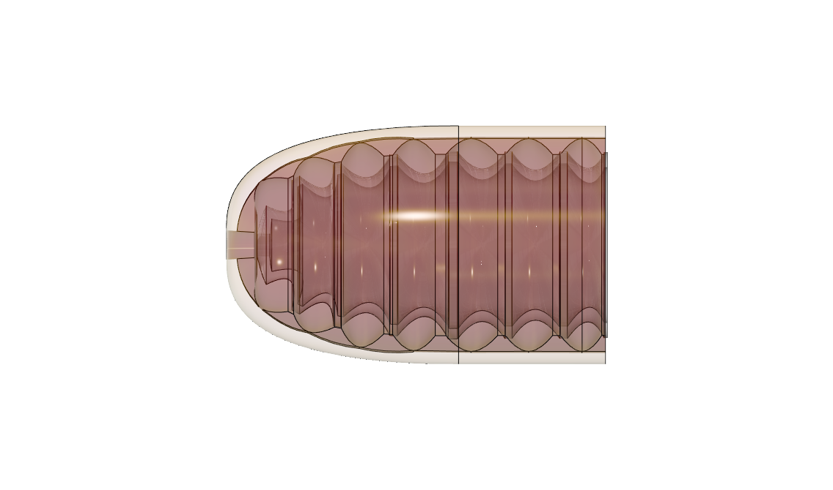
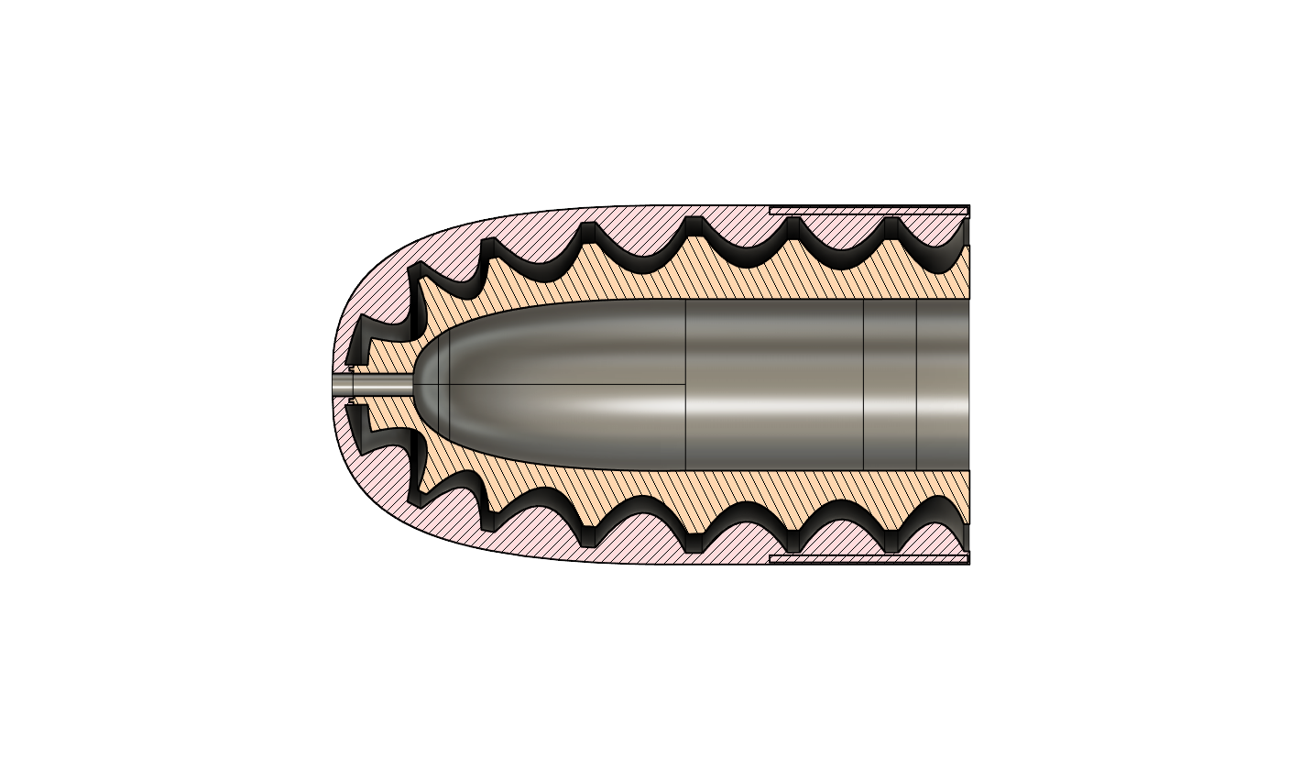
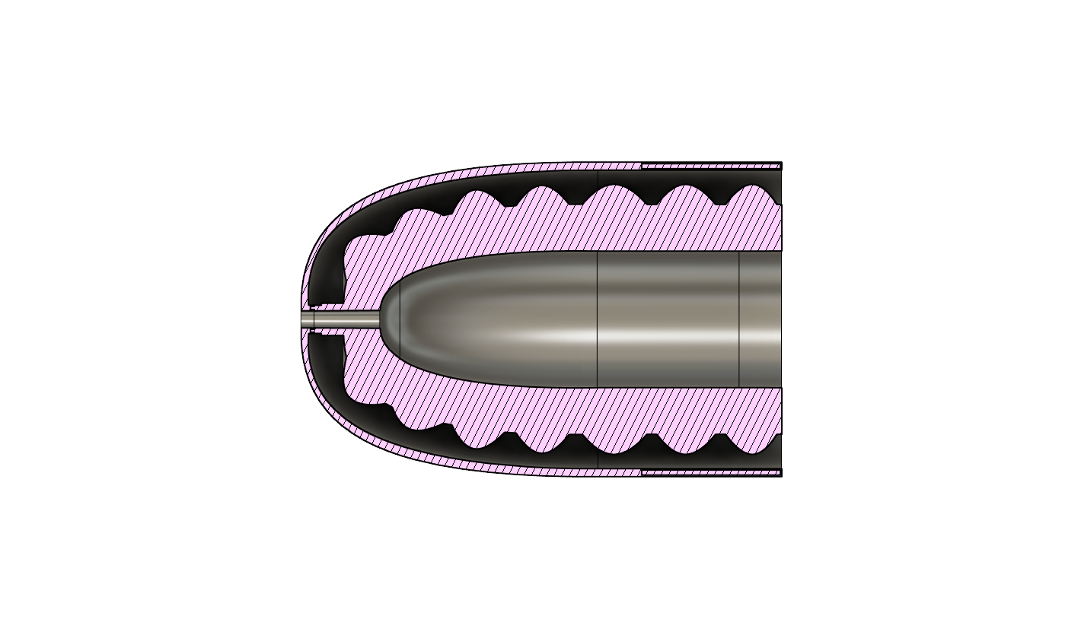
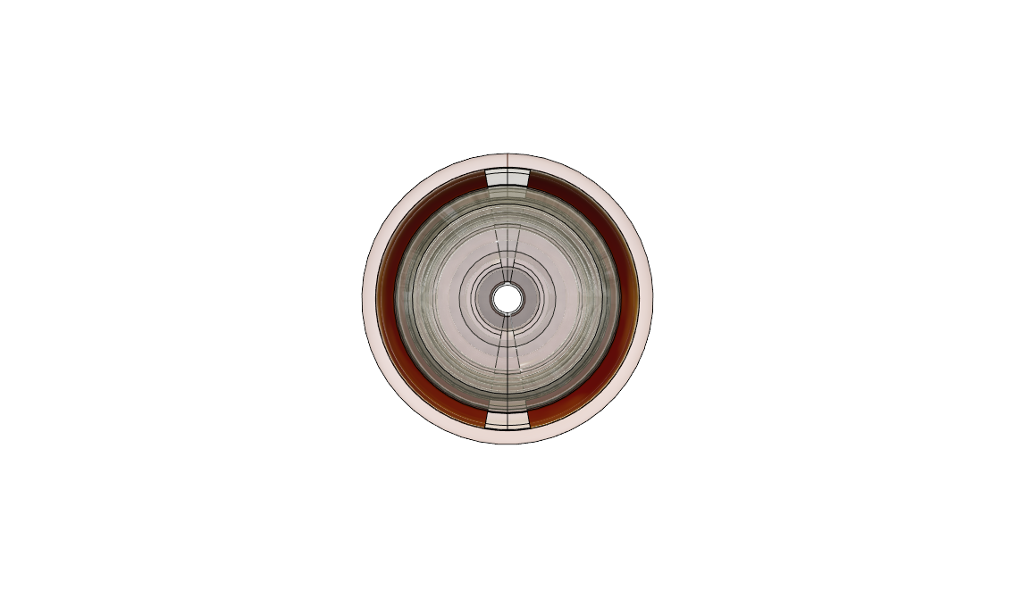
The Silicone haptic device
3D Model of the cast
Two layer silicone rubber with internal hollow channels.
Thickness of approximately 1mm.
Inlet and Outlet channel integrated in the layers.
Cast the top layer and the bottom layer separately.
Side View
Inlet
Mold cross-section for the outer layer
Mold cross-section for the inner layer
Outlet
Back View
Source of Images: author

Slide 10
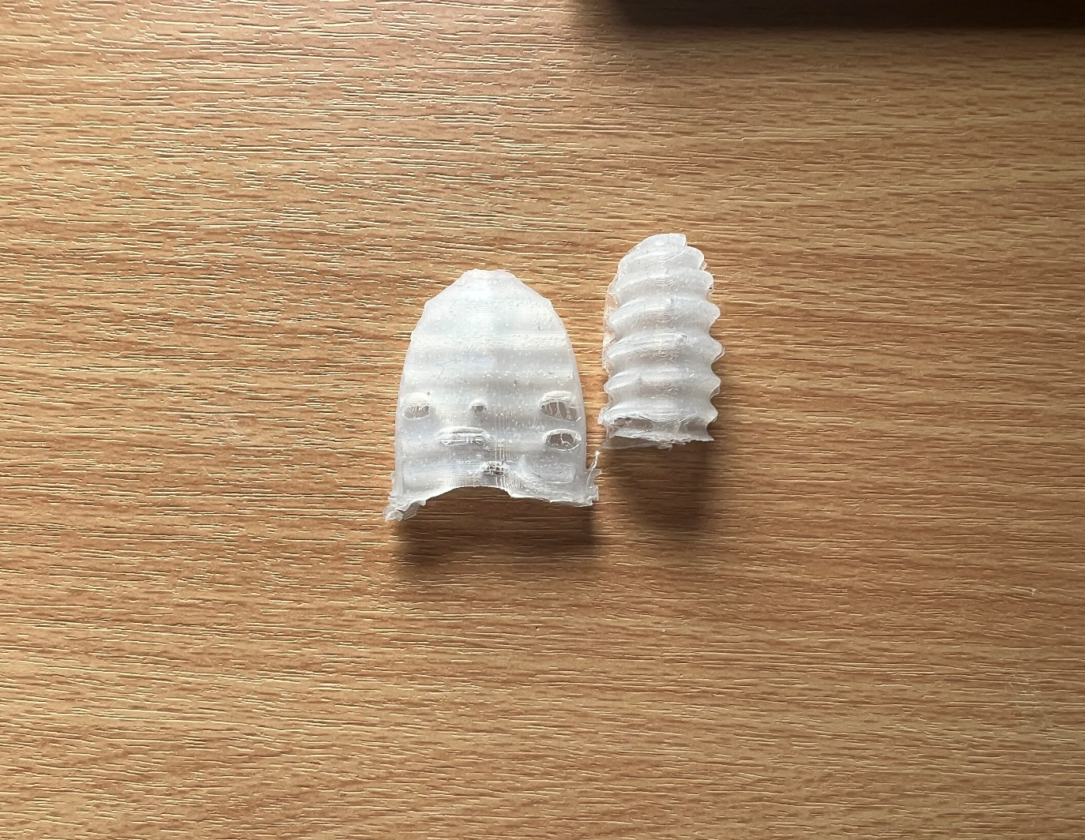
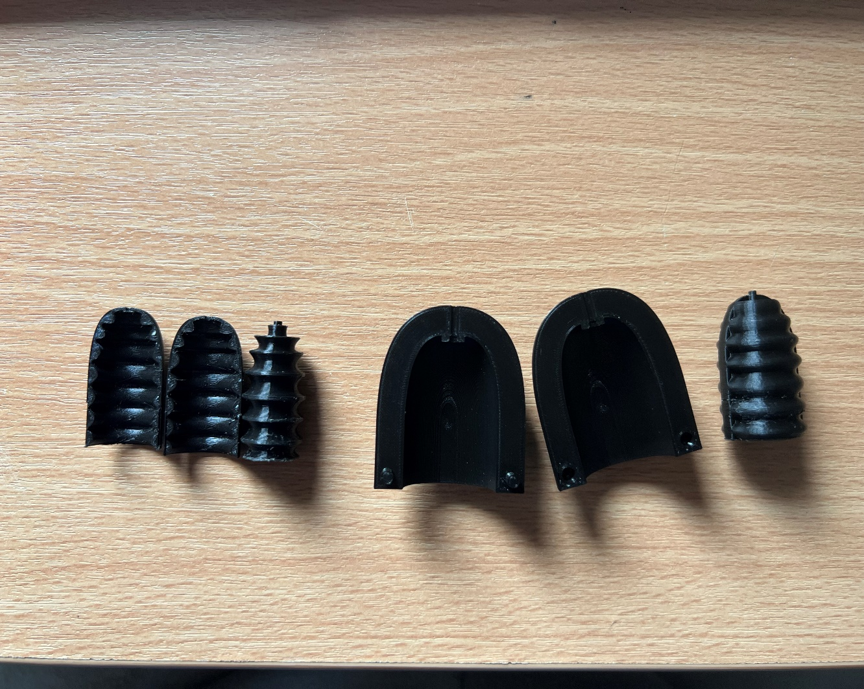
Results from the early prototypes
Incomplete casts, air bubbles and deformations.
Difficult to extract and assemble.
Air bubbles
Deformed cast
Source of Images: author
Inner layer mold
Outer layer mold

Slide 11
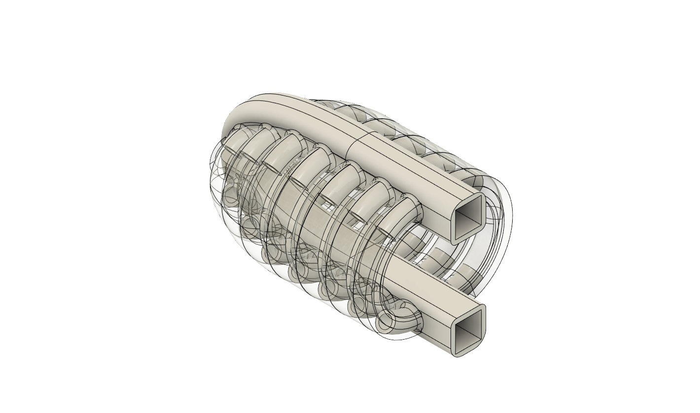
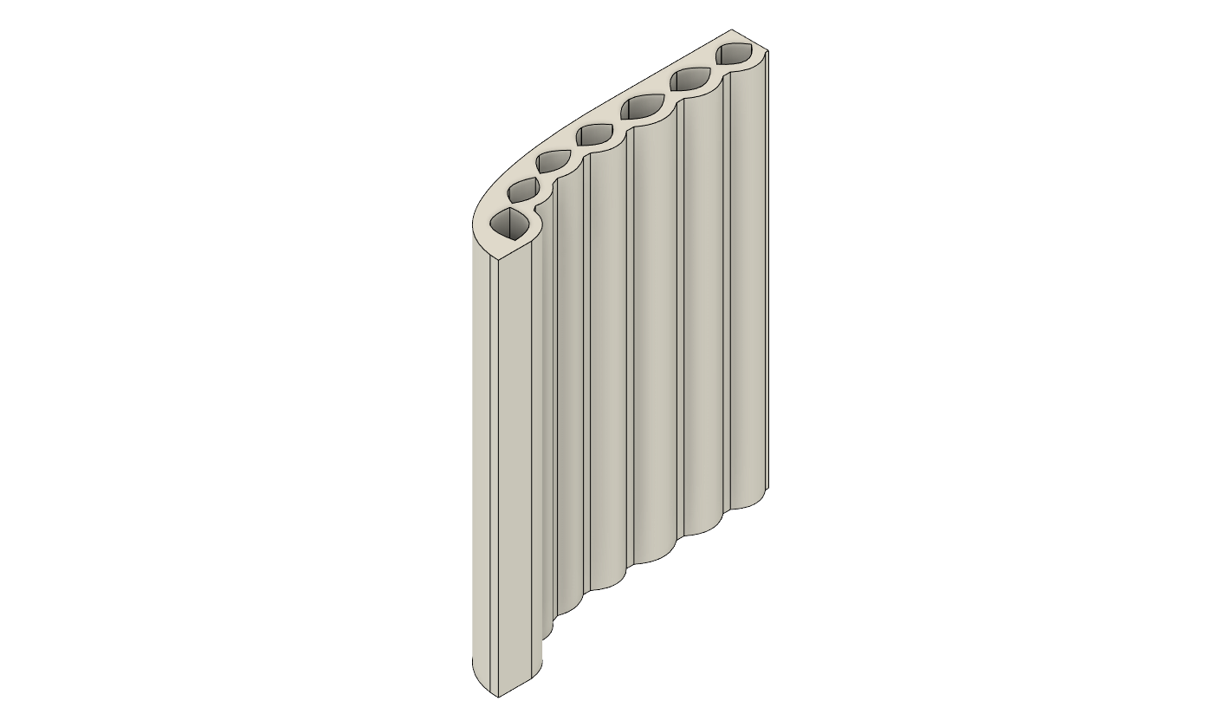
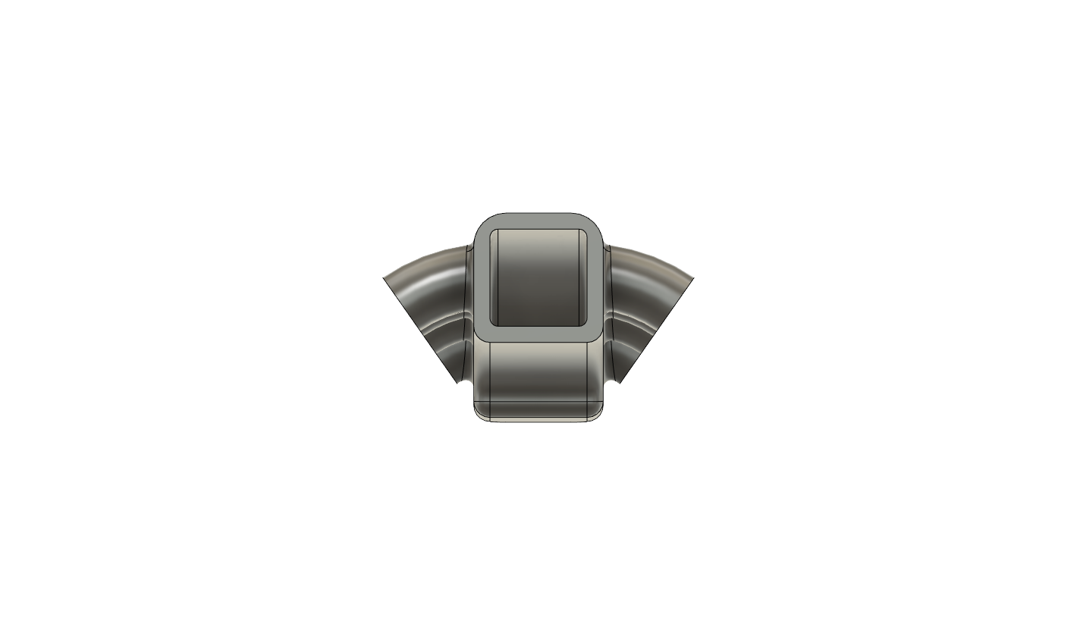
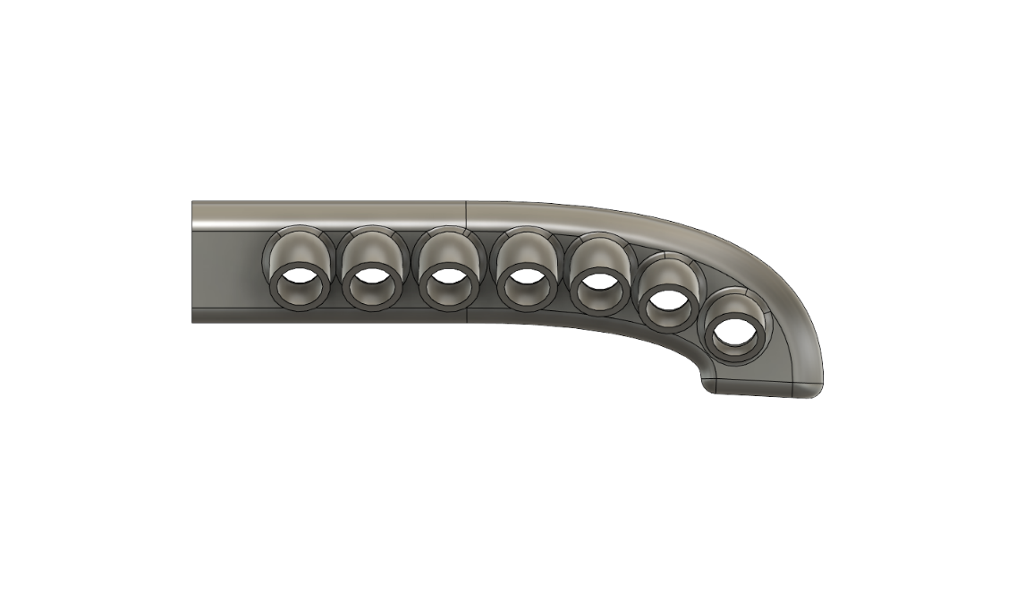
Two layered silicone skin
Final Iteration
The top layer and the bottom layer casted together.
Cast the upper half and the lower half separately.
Use 3d printed pipes which connect the top half to the bottom half and also act as the inlet/outlet pipe for the fluid.
Inlet/outlet Port
3D model of the final iteration
Fluid distribution channels
Silicone rubber skin
3D printed I/O Pipe
Source of images: author

Slide 12
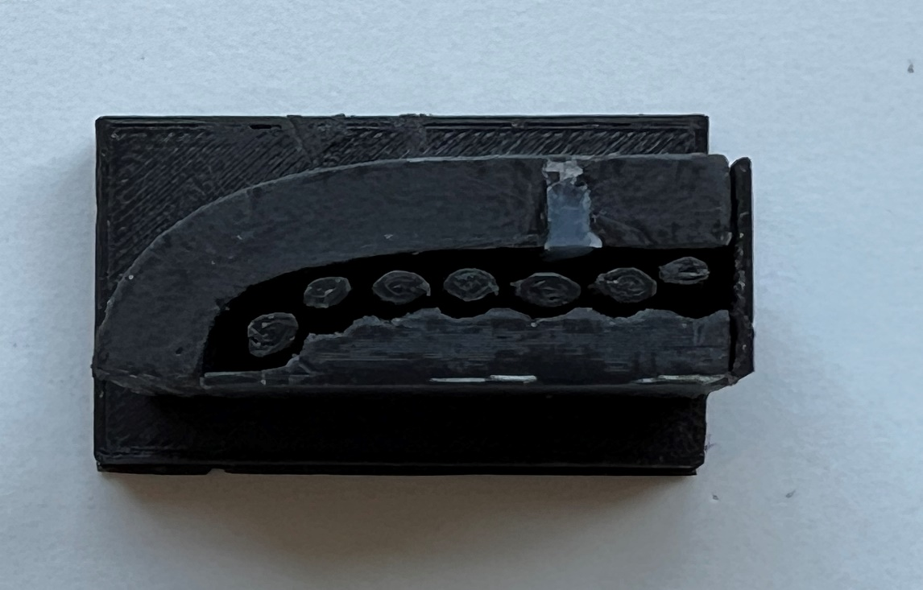
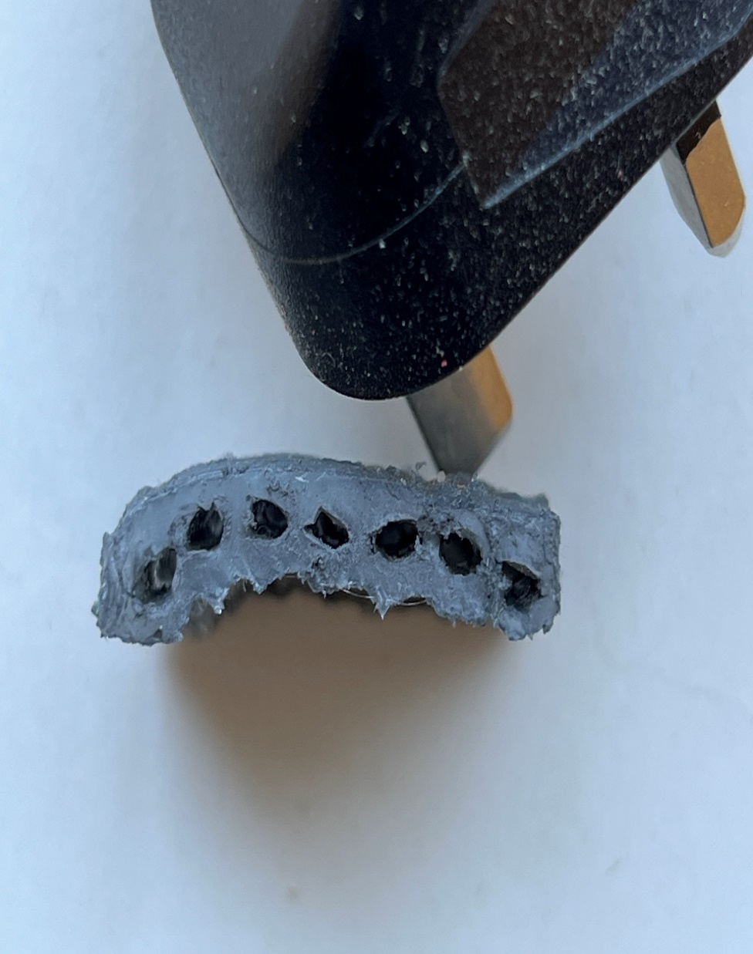
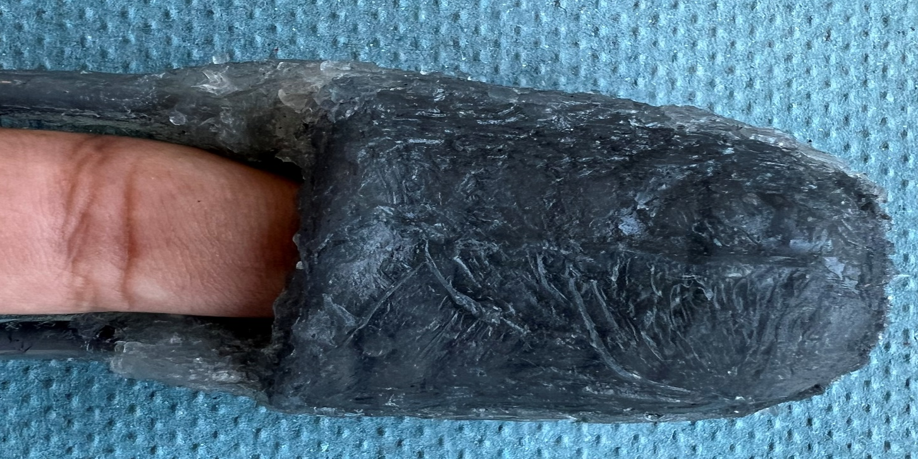
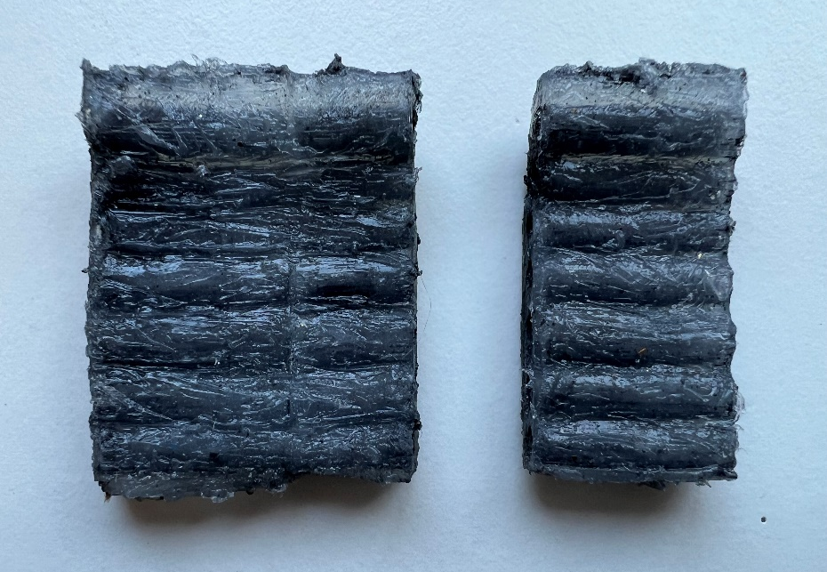
Internal Channels
4mm
Improved Mold design
Outlet Pipe
Index Finger
60mm
40mm
Inlet pipe
Bottom layers
Top layers

Slide 13
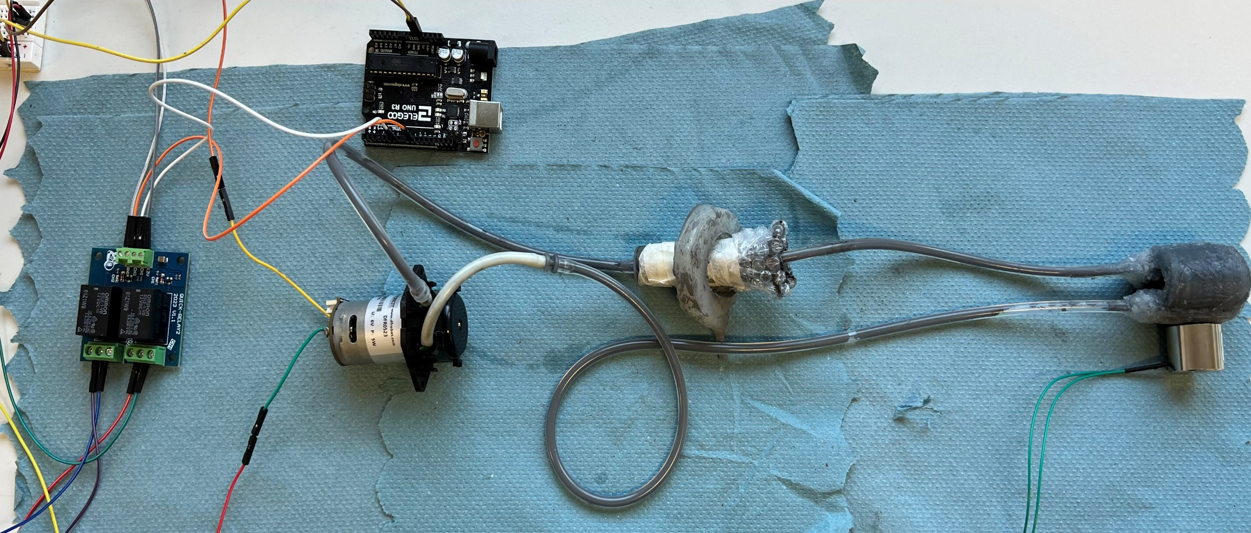
Overall System
Source: author
Arduino Uno
Reservoir
Haptic device
Outlet
Inlet
Electromagnet
2-channel Relay
Peristaltic Pump

Slide 14
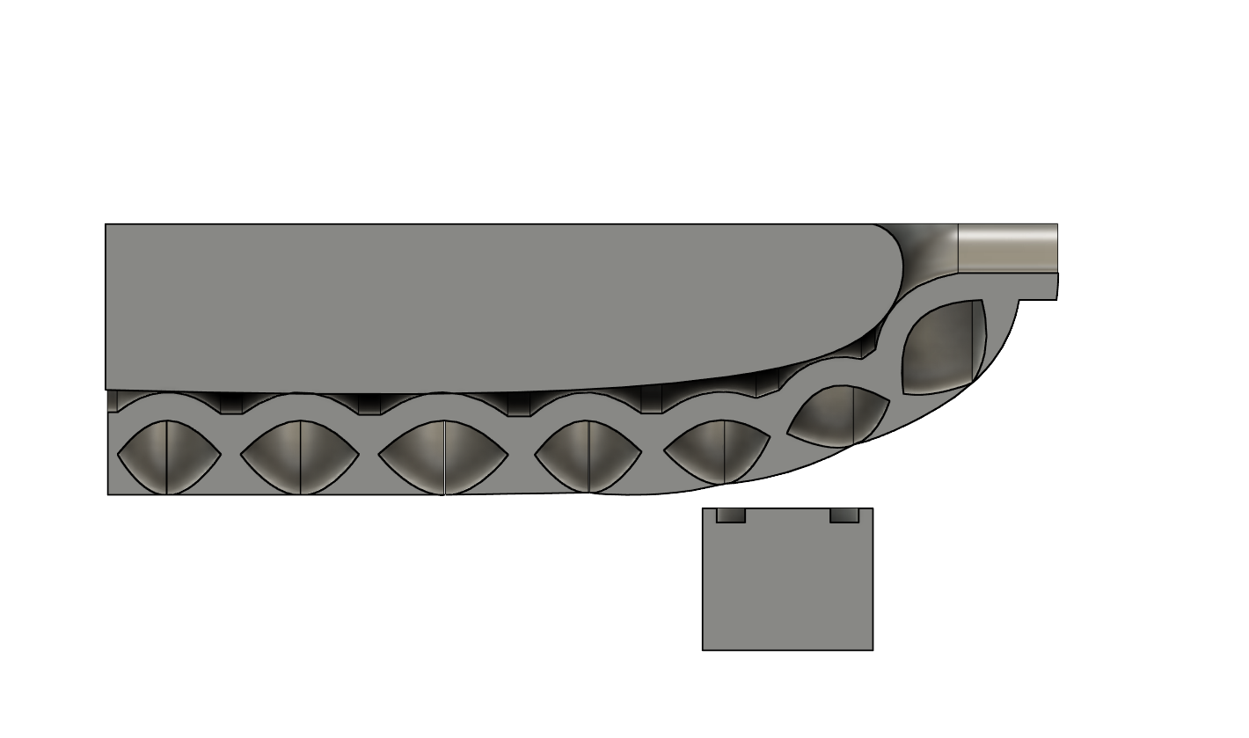
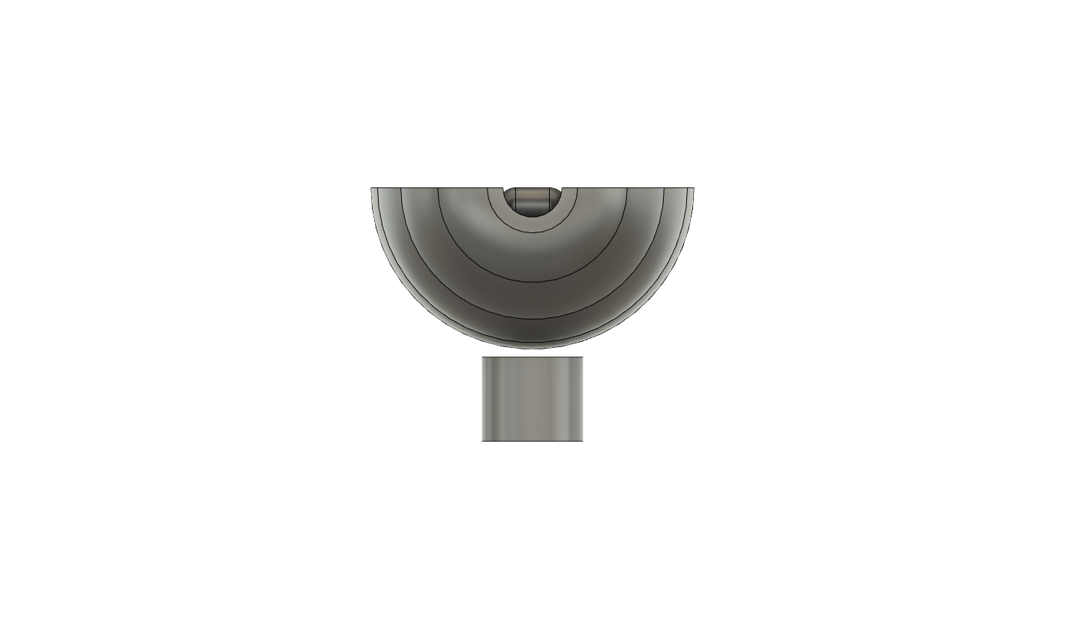
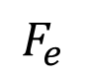



Generation of Normal and Shear forces
Normal Forces
Chain Formation of the ferromagnetic particles exerts pressure on the inner wall.
Creates a pulse on the finger
Shear Forces
Fluid turns semi solid as electromagnet is turned ON, exerts pressure on inner wall.
The combination of force from the chain formation and pump.
Source: author
Finger
Silicone Haptic device
Inner wall
Finger
Source: author
$$F_{e}$$
$$F_{l}$$
$$F_{e}$$
Haptic Device
$$F_{p}$$
Electromagnet
Internal hollow Channels
Electromagnet

Slide 15
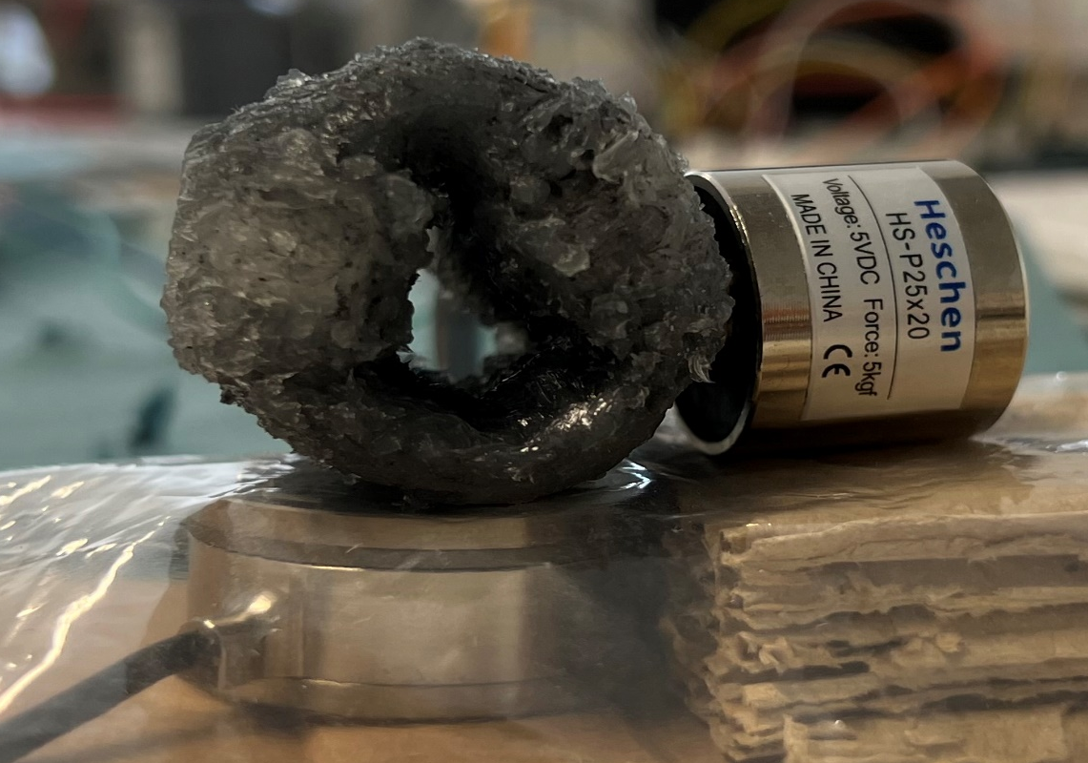



Results
The forces generated by the haptic device is measured using a 6-axis load cell.
The activation time of the electromagnet is varied and the forces and torque generated are captured.
Source: author
$$T_{z}$$
Haptic device
+Z
Electromagnet
+X
+Y
Load Cell
$$T_{x}$$
$$T_{y}$$

Slide 16
Evaluation of Normal force generation
Keeping the pump OFF, the electromagnet is magnetized and demagnetized with a delay.
The system is evaluated for activation time of 1000 milli second, 600 milli second, and 200 milli second.
The forces produced in the Z direction is measured and evaluated.

Slide 17
Source: author
Activation time:- 1000 milli second

Slide 18
Source: author
Activation time:- 600 milli second

Slide 19
Source: author
Activation time:- 200 milli second

Slide 20
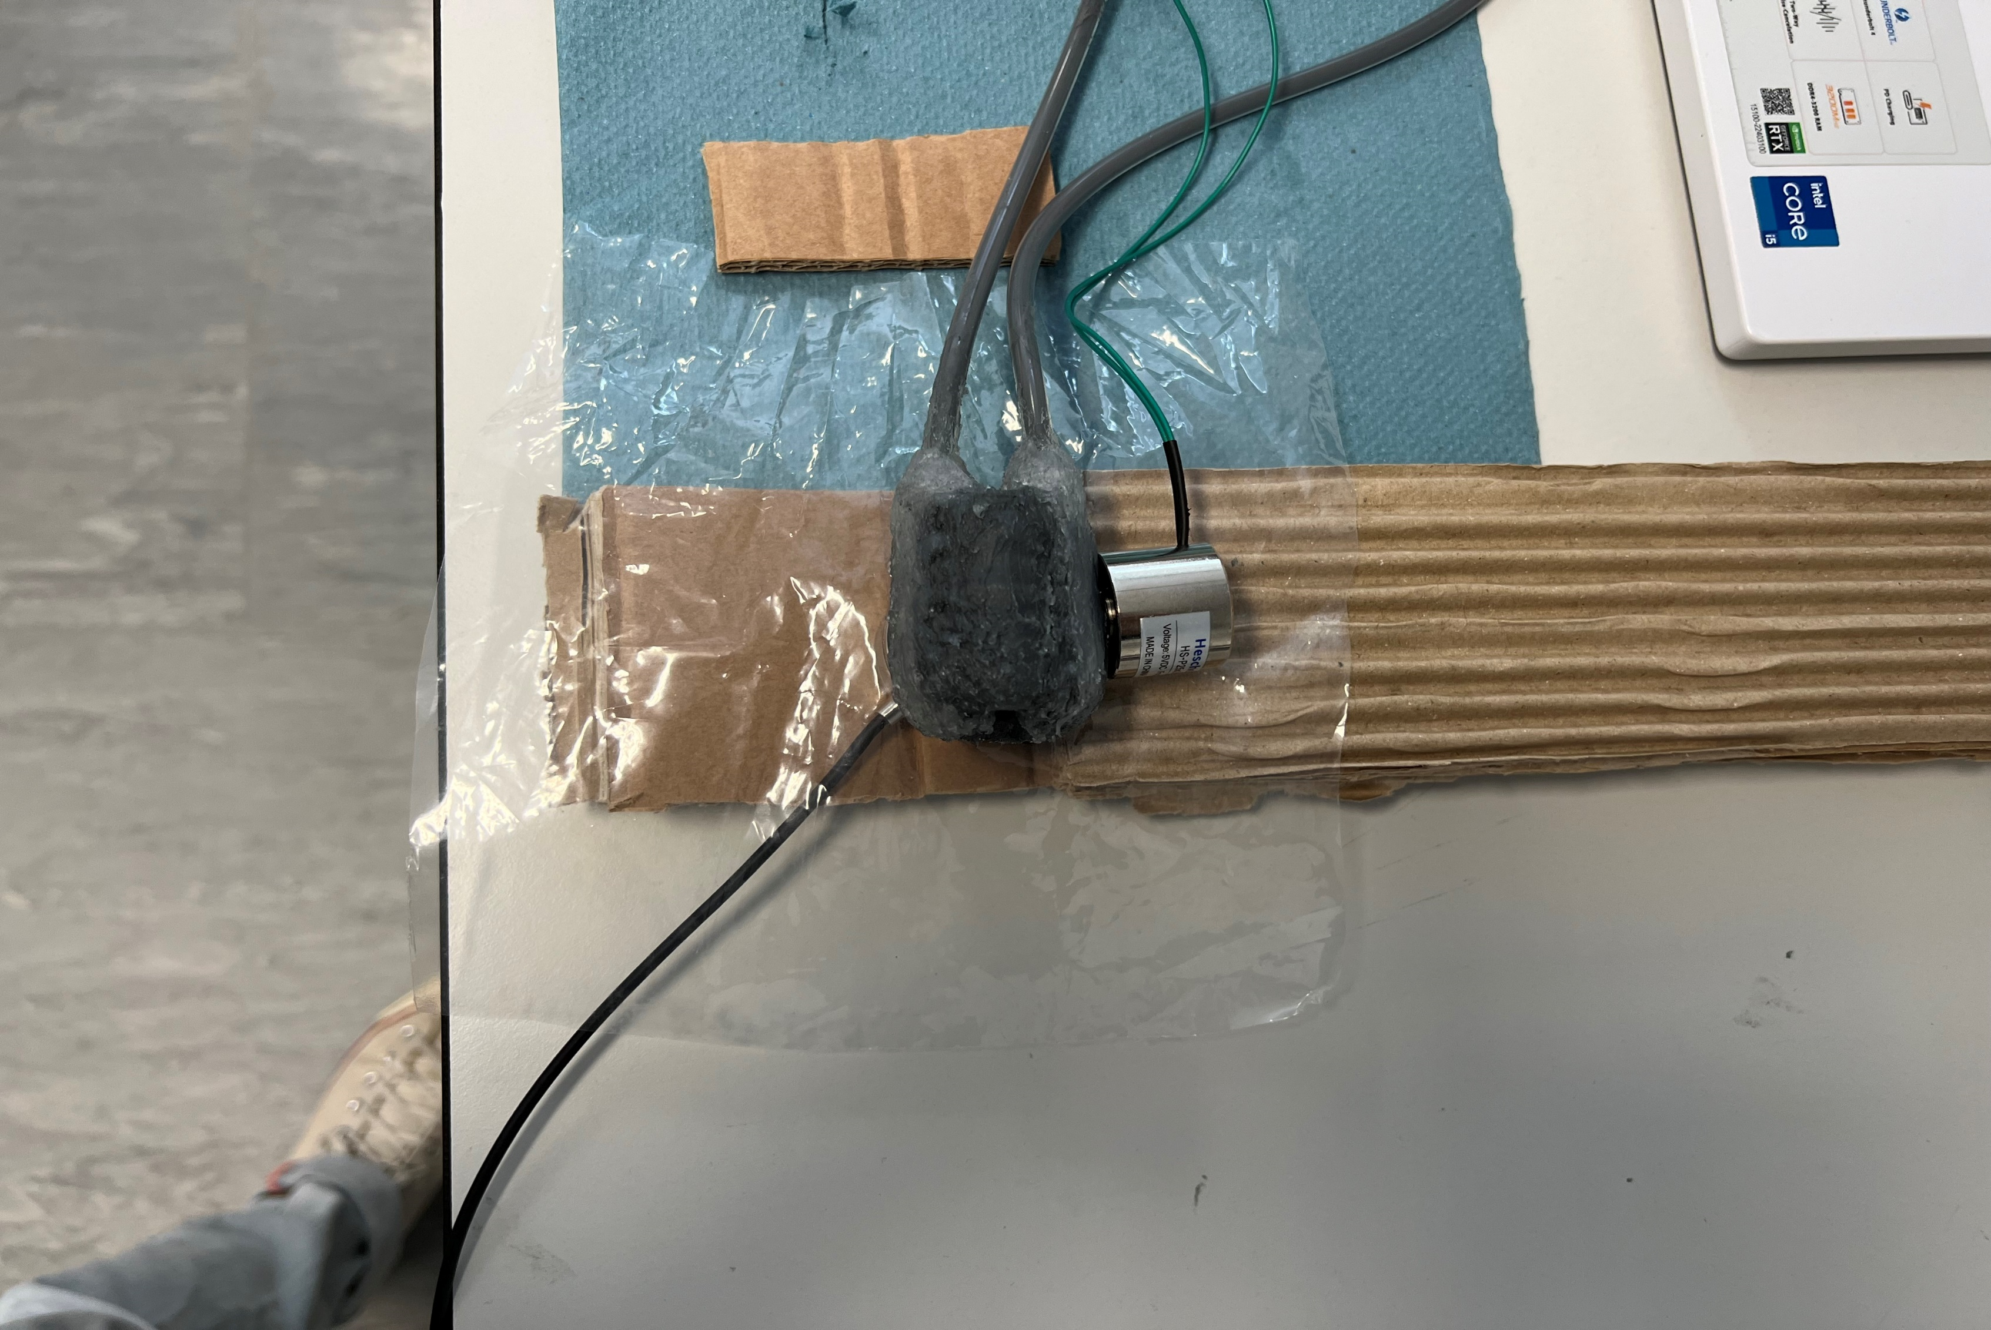



Evaluation of Shear forces generation
Source: author
The Pump for this test is always ON.
The system is evaluated with for a delay time of 50 milli second.
The forces in Z direction and torque in Y,Z is evaluated.
Flow direction
$$F_{z}$$
$$T_{x}$$
$$T_{y}$$

Slide 21
Source: author
Forces in Z direction

Slide 22
Source: author
Torque produced in X and Y direction

Slide 23
Conclusion and future work
Conclusion
The normal forces and shear forces are easy to generate but low in magnitude.
It is important to ensure waterproof seals between the silicon rubber skin, the 3D pipes and the inlet/outlet pipes.
The electromagnets provides instant magnetization and demagnetization, however generates heat after a while.
The fluid responds instantly, however, ferroparticles are segregated from the base oil after 24 hrs, if not used.
Future Work
A control mechanism for varying the magnetic intensity.
The design of the silicone haptic device.
An alternative to relays, the modules gets noisy for very quick switching tasks.
A MR Fluid with better stability and homogeneity.

